Slide 1

Singapore Power Visual
User Guide

Slide 2

Content Page
1
Overview
2
Clustering Analysis
Provides an overview of electricity consumption in Singapore
Uncovers patterns through various clustering methods
Consumption by Planning Area & Dwelling Type
Electricity Consumption Trend
TBC
Hierarchical Clustering
Time Series Clustering
3
Inferential Analysis
4
Time Series Forecasting
Draws inference from statistical tests with various parameters
Predict future consumption trends with various models
ANOVA
Correlation Analysis (TBC)
Forecasting
Slope Graph (TBC)

Slide 3
Overview
Through the integration of interactive features, this section offers valuable insights into the electricity consumption patterns in Singapore. Users are free to explore and visualize the data by regions, planning areas and dwelling types over time.
Insert screenshot here

Slide 4
Consumption by Planning Areas
User Interface & Parameters

Slide 5
Clustering Analysis
A range of clustering methods are provided in this section to uncover clusters with distinct electricity consumption patterns based on parameters calibrated by users.
Insert screenshot here

Slide 6
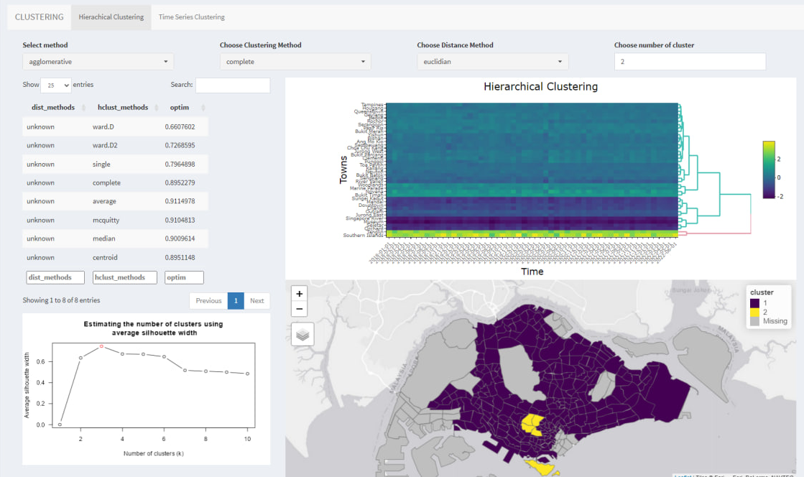
Hierarchical Clustering
User Interface & Parameters
User to select a distance function from the drop-down list.
This table helps user determine the best clustering method based on the distance function selected in 1. The clustering method with higher optimum value is recommended.
User to select a clustering method from the drop-down list.
A silhouette graph helps user determine the optimal number of cluster.
User to input the number of clusters.
The heatmap with dendrogram shows the clusters based on the selected criteria. Users can hover over the heatmap to view more information of the planning areas.
The choropleth map shows the geographical location of the clusters. Users can hover over the choropleth map to view more information of the planning areas.
User to select a seriation algorithm from the drop-down list. This selection specify the method for ordering the rows and/or columns of the heatmap.
1
2
3

Slide 7
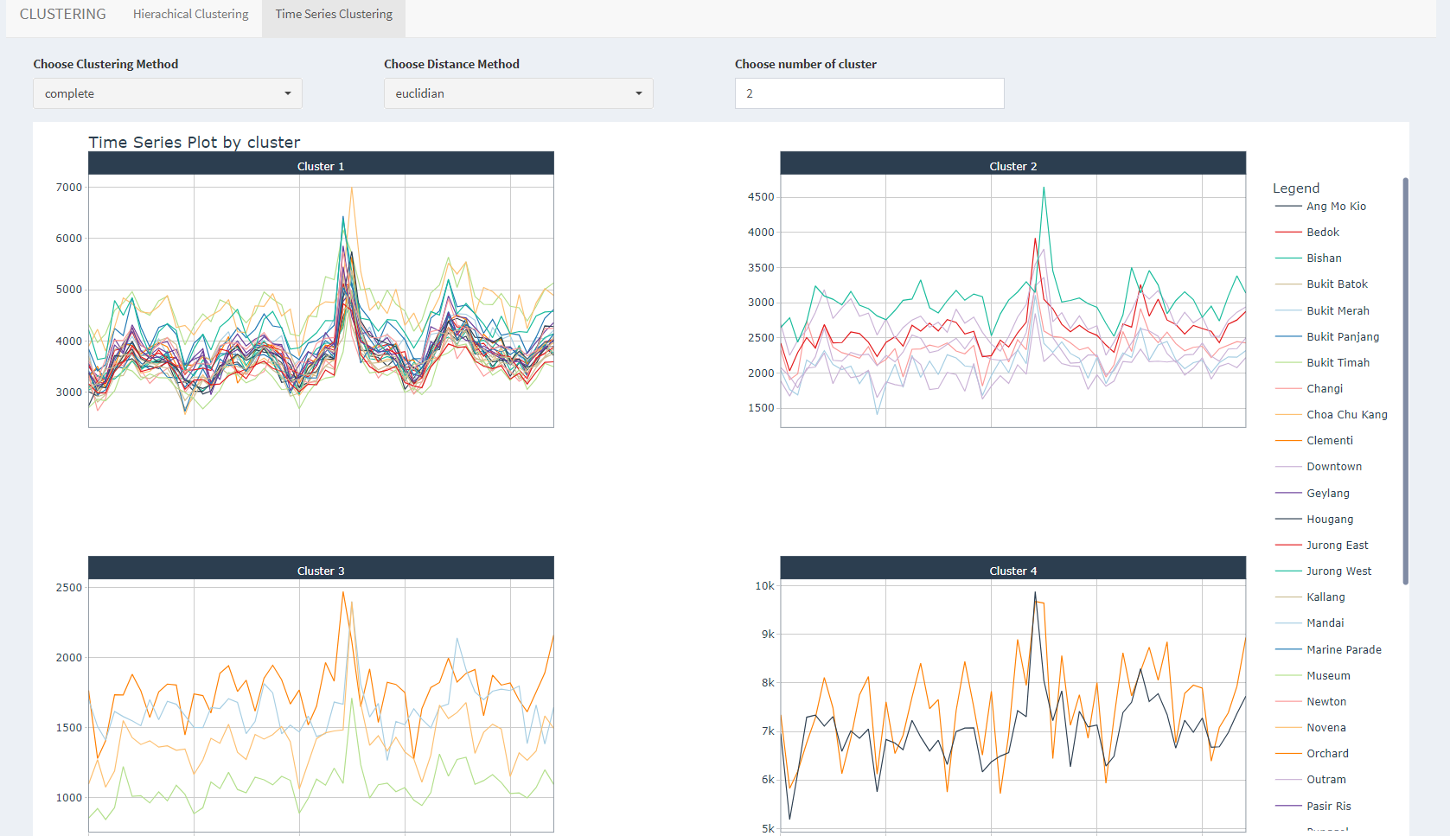
Time Series Clustering
User Interface & Parameters
User to select a clustering method from the drop-down list.
User to select a distance function from the drop-down list.
User to input the number of clusters.
The line charts of consumption over time are grouped by cluster and shown in a facet view to display the trend of each cluster.
1
2
3

Slide 8
Inferential Analysis
TBC
Insert screenshot here

Slide 9
ANOVA
User Interface & Parameters

Slide 10
Time Series Forecasting
This section offers a range of prediction models to forecast future electricity consumption trends

Slide 11
Time Series Forecasting
User Interface & Parameters

